Slide 1
Immo Eliza
Analyzing data & visualization
Mykola Senko
Junior Data Scientist in BeCode.org

Slide 2
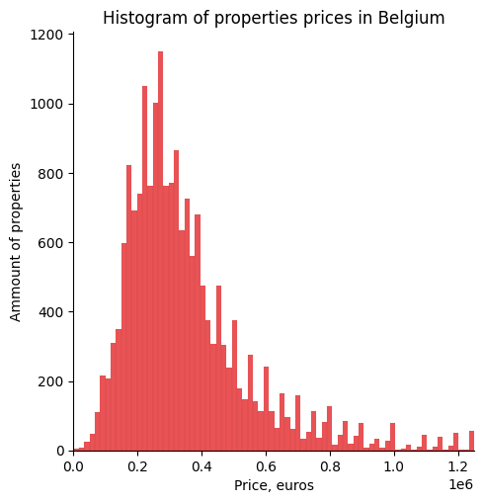
Property prices in Belgium

Slide 3
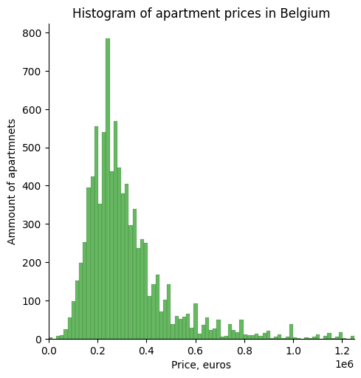
Apartment prices in Belgium

Slide 4
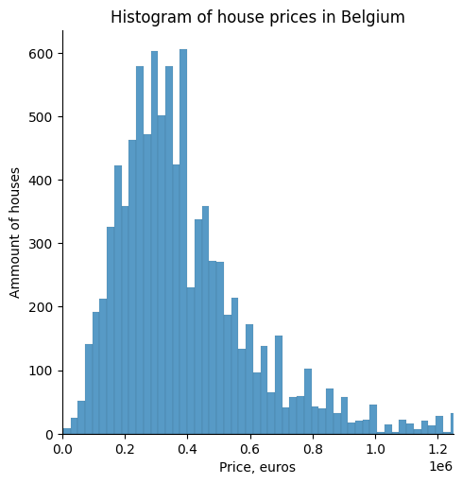
House prices in Belgium

Slide 5
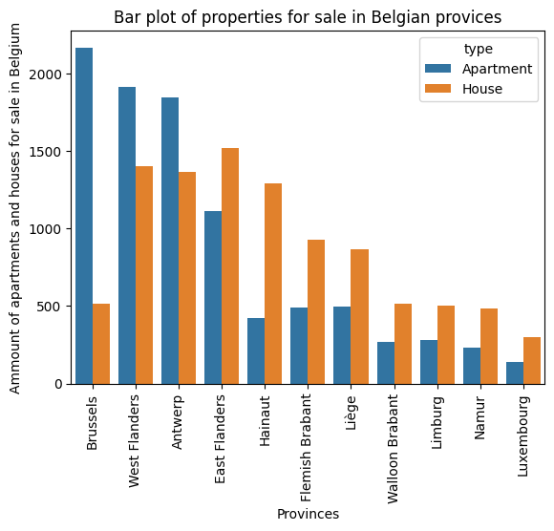
Properties for sale in provinces of Belgium

Slide 6
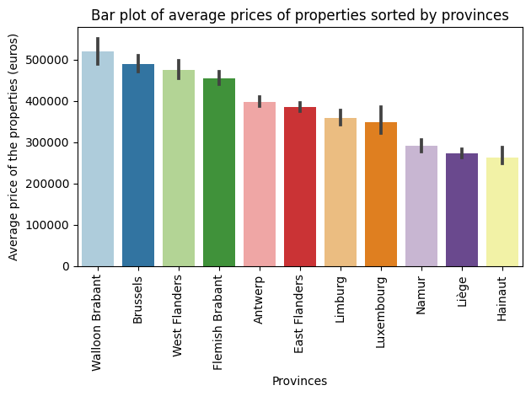
Average prices of properties sorted by provinces

Slide 7
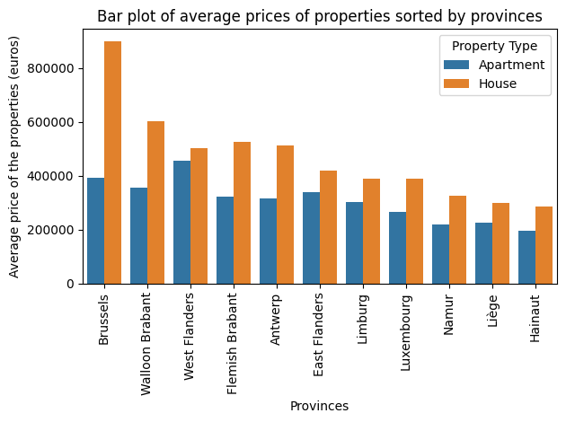
Average prices of apartments and houses sorted by provinces

Slide 8
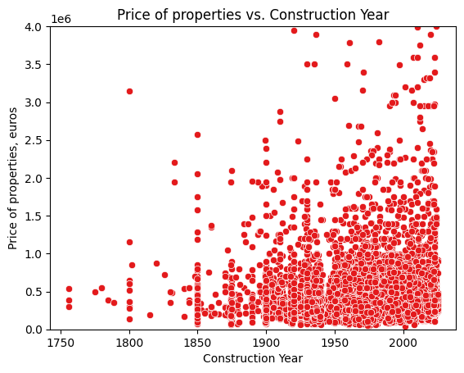
Prices of properties depending on construction year

Slide 9
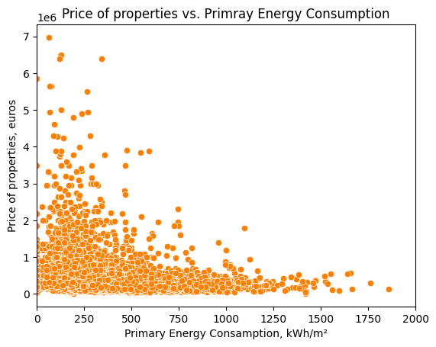
Prices of properties depending on Primary Energy Consumption

Slide 10
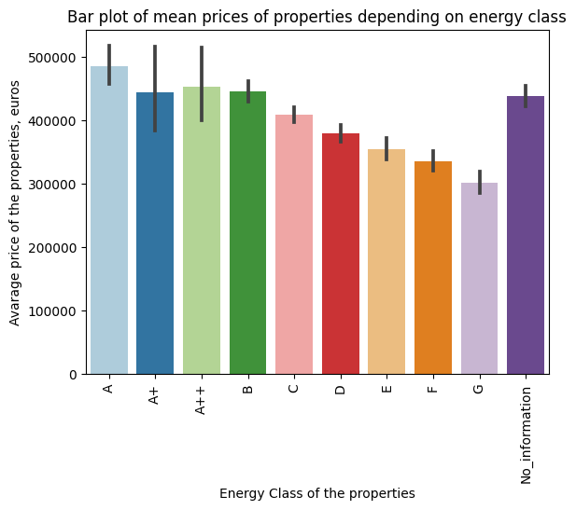
Average prices of properties depending on Energy Score

Slide 11
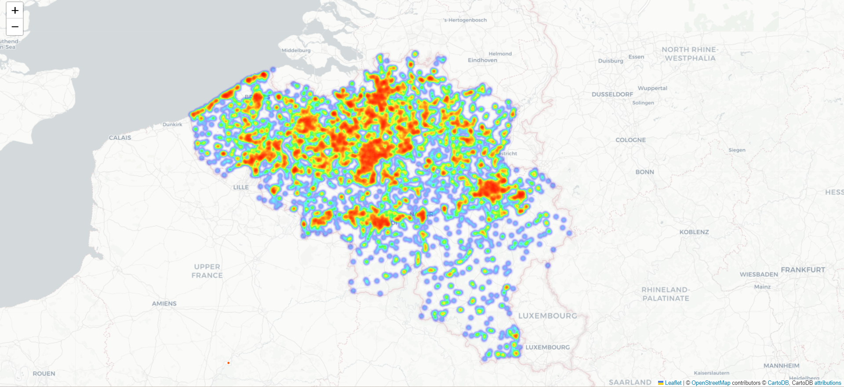
Density of properties for sale

Slide 12
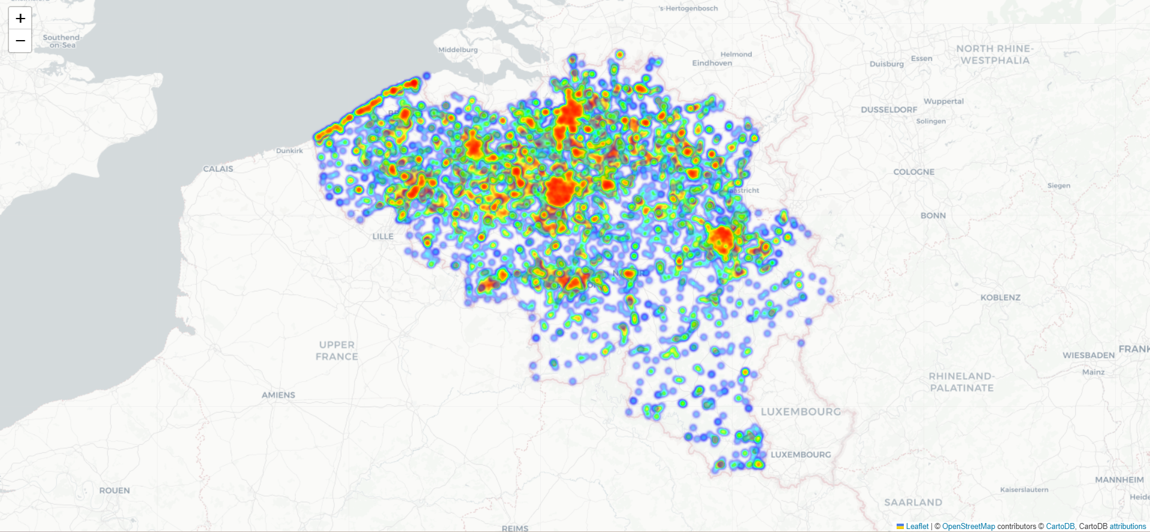
Density of apartments for sale

Slide 13
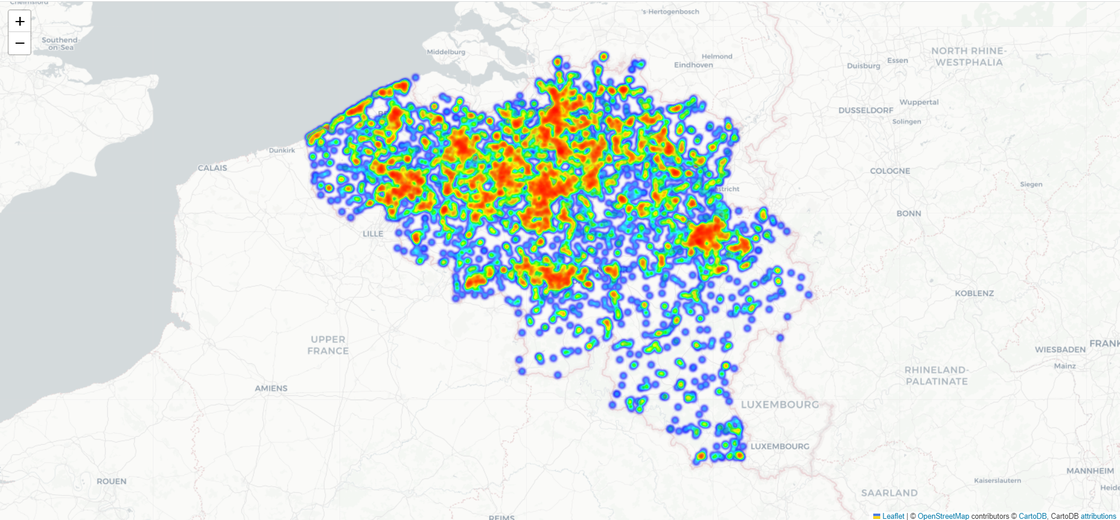
Density of houses for sale

Slide 14
The project was made under the supervision of Vanessa Rivera Quiñones(https://www.linkedin.com/in/vriveraq/) and Samuel Borms(https://www.linkedin.com/in/sam-borms/?originalSubdomain=be)
Gent | July 11, 2023

